Slide 1
How to make good text classifiers without a lot of data
Toby Sachs-Quintana

Slide 2

Application: keeping track of trending issues
Low data situation
The number of documents for a set of issues is small
10 - 100 training examples, not 1000s
It can be hard to find trending issues

Slide 3
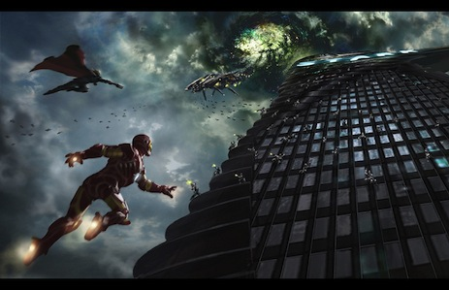
Detecting trending issues is important for customer service
Stopping problems before they become really big problems
Helps the product development cycle
If only Ironman could’ve spot this trending issue earlier!

Slide 4

Machine learning and automation to the rescue!

Slide 5

Steps to fix the problem of detecting trending issues
Tools to test for over-fitting
Simple models
Multi-dimensional word vectors
Neural nets
Transfer learning (using big data to solve small data)

Slide 6
20 newsgroups public dataset
Training data
1800 newsgroups posts on 20 topics
Rec.motorcycles vs. rec.autos
Filter headers, footers, and quotes
Tokenize and lemmetize ‘autos’ = ‘auto’
Newsgroups | Number of posts
Autos | 594
Motorcycles | 598
Test data
Newsgroups | Number of posts
Autos | 396
Motorcycles | 398

Slide 7
Cross-validation curves are a great tool to measure over-fitting.
Test
Train
Error
Model complexity
number of features

Slide 8
Cross-validation curves are a great tool to measure over-fitting.
Test
Train
Error
Score
Model complexity
number of features
Model complexity
number of features

Slide 9
Learning curves are a great tool to measure bias.
Test
Train
Score
Number of training examples

Slide 10
Learning curves are a great tool to measure over fitting.
Test
Over fit
Under fit
Train
Score
Number of training examples

Slide 11
Learning curves are a great tool to measure bias.
Test
Train
How to fix over fitting
Less features
More data
More regularization
How to fix under fitting
More features
Less regularization
Over fit
Under fit
Score
Number of training examples

Slide 12
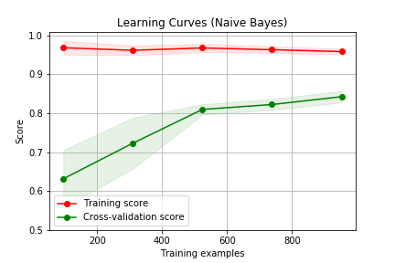
Naïve bayes
Probability of document being a class is joint probability of the words indicating the class
Accuracy = 97%
@@ less training examples its xxx
The area we care about

Slide 13
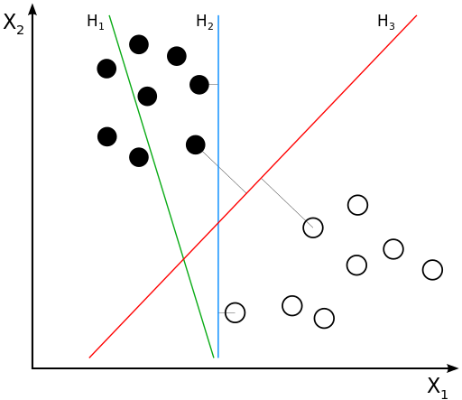
Support Vector Machines
Maximize separation
Non linear separation is fast
Regularization penalty for more features

Slide 14
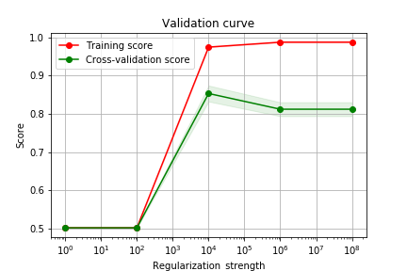
Support Vector Machines
Regularization coefficient of 1e6 determined by regularization curve
Rbf kernel

Slide 15
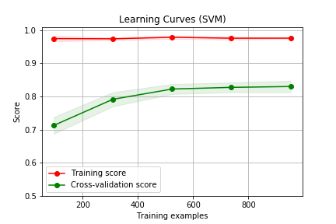
SVM learns faster than naïve bayes

Slide 16
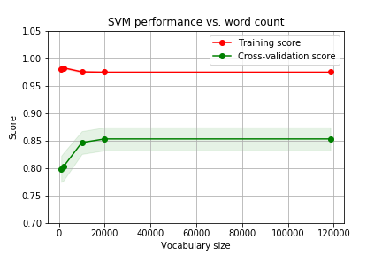
Vocabulary needed for SVM
Increasing the regularization strength allows for more features (words)

Slide 17
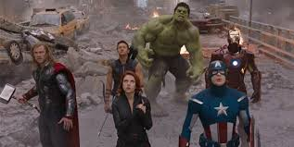
Word vectors
Predict center hero
based on context heroes
Previously words were represented as a single number
Now a word is represented as a vector.
Predict surrounding words based on center words
Use gensim word2vec

Slide 18
Word vectors
Previously words were represented as a single number
Now a word is represented as a vector.
Predict surrounding words based on center words
Use gensim word2vec

Slide 19
Check the vector similarity
model_100.wv.doesnt_match(['wheel', 'car', 'wave'])
Helpful for debugging before applying a model
Word Dimensionality | Corpus used for training | Word that does not belong
2 | Twenty newsgroups | car
100 | Twenty newsgroups | wave
300 | Google news | wave

Slide 20
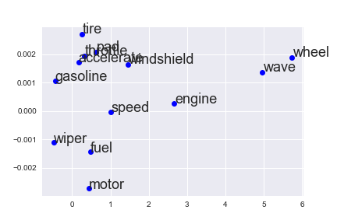
Check the vector similarity

Slide 21
Documents can be built by averaging the vectors or stacking them
Example phrase “engine fuel”
 | X1 | X2
engine | 2.8 | 0.0002
fuel | 0.2 | -0.0013
Y
X Engine fuel
X

Slide 22
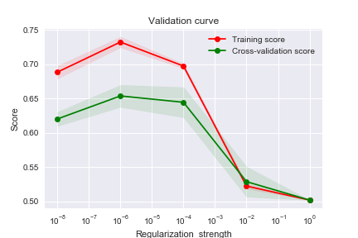
Performance of SVM averaging word vectors

Slide 23
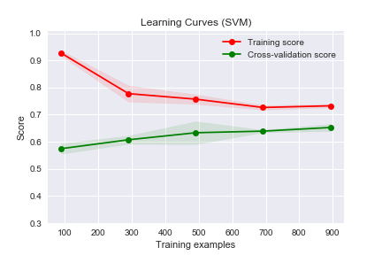
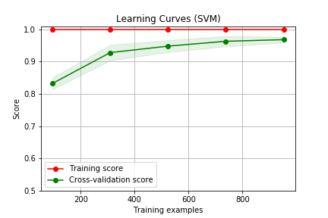
TF-IDF performs better than word embeddings
SVM using average word embeddings
SVM using TF-IDF vectorization

Slide 24
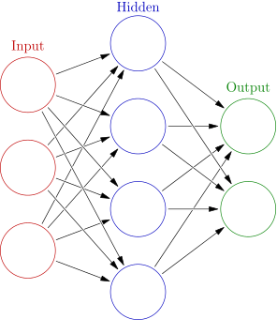
Simple neural network
300 hidden units
300 input units
200 outputs
Notes:
By Glosser.ca - Own work, Derivative of File:Artificial neural network.svg, CC BY-SA 3.0, https://commons.wikimedia.org/w/index.php?curid=24913461

Slide 25
Simple neural network
300 hidden units
300 input units
 | Features
Input to hidden | ~90K
Hidden to output | ~600
2 outputs
Notes:
By Glosser.ca - Own work, Derivative of File:Artificial neural network.svg, CC BY-SA 3.0, https://commons.wikimedia.org/w/index.php?curid=24913461

Slide 26
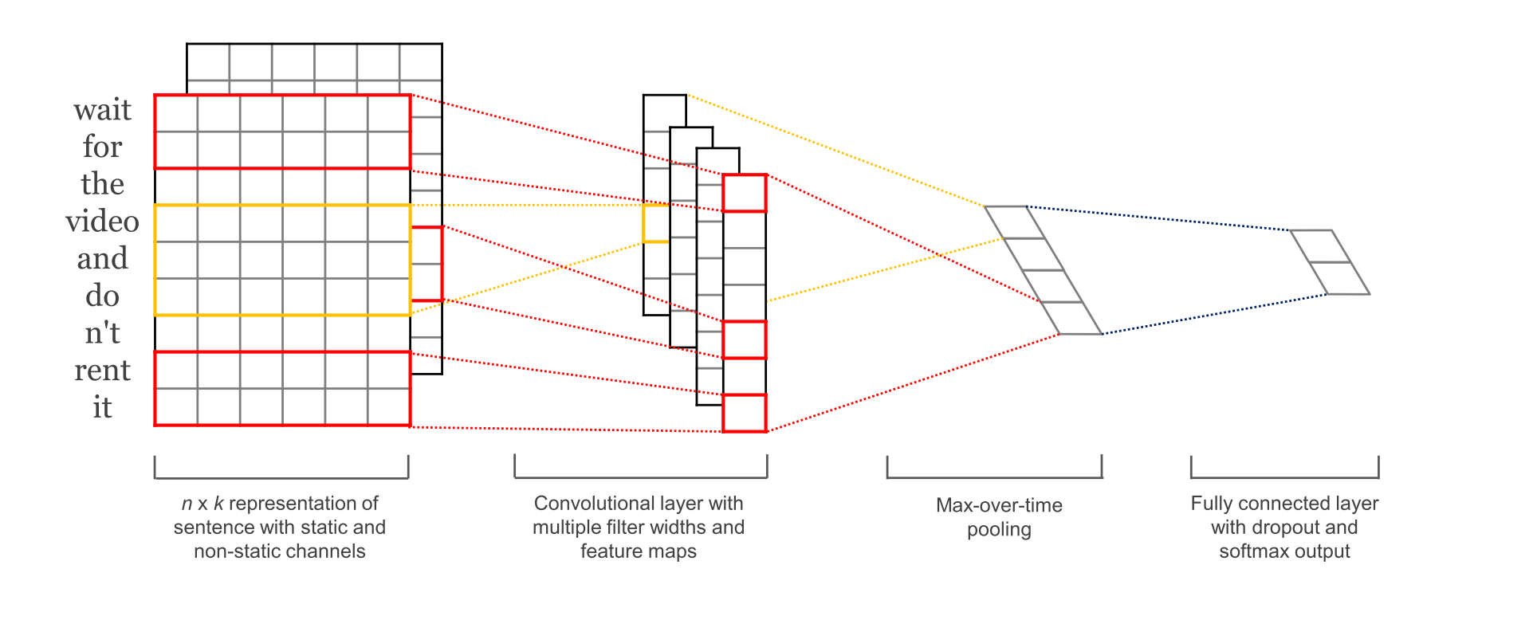
Convolutional Neural Networks
Documents are transformed to two dimensional arrays.
Apply the same algorithm that is used for images

Slide 27

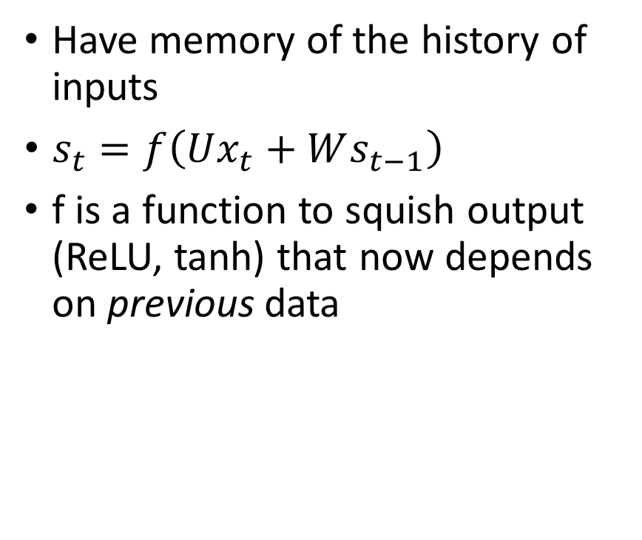
Recurrent Neural Networks
Have memory of the history of inputs
$s_{t}=f\left(Ux_{t}+Ws_{t−1}\right)$
f is a function to squish output (ReLU, tanh) that now depends on previous data

Slide 28
Transfer learning
Train one model on a larger dataset to get the initial weights.
Save the weights
Feed in the new data and adjust the weights

Slide 29
Training time for the different models
Metric | Naïve Bayes | SVM | Two layer NN | CNN w/ custom embeddings | RNN
Accuracy | 0.63 | 0.71 | 0.88 | 0.95 | 0.95
Training time | < 1s | < 1s | > 6h | > 6h | > 6h

Slide 30

Conclusions
Not a lot of data is needed to leverage deep learning (100 examples for >80% accuracy)
If training time is a major concern, then SVM is a good alternative
The real question is how long you want to wait for the model

